Slide 1
Knesset Project
Group 107
Oryan Hassidim | Betzalel Yanir | Avi Sommer
Mr. Effi Levi | Prof. Shaul Shenhav

Slide 2
Problem
Informed choices vs. Regular political tracking
One statement vs. Overall perception

Slide 3
Solution
Big political database
Data (and sentiment) analysis using AI
Useful, simple, user-friendly UI for analysis display

Slide 4
Solution
Big political database
Data (and sentiment) analysis using AI
Useful, simple, user-friendly UI for analysis display
Existing Work:
IsraParlTweet – Raw Database – the Israeli parliamentary and Twitter resource
Guy Mor-Lan, Effi Levi, Tamir Sheffer, Shaul R. Shenhav ~ HUJI
Knesset-DictaBERT – a Hebrew language model for parliamentary proceedings
Gili Goldin, Shuly Wintner ~ University of Haifa
Political – similar idea, but on much smaller scale – a startup for making political information more accessible
Itai Leshem

Slide 5

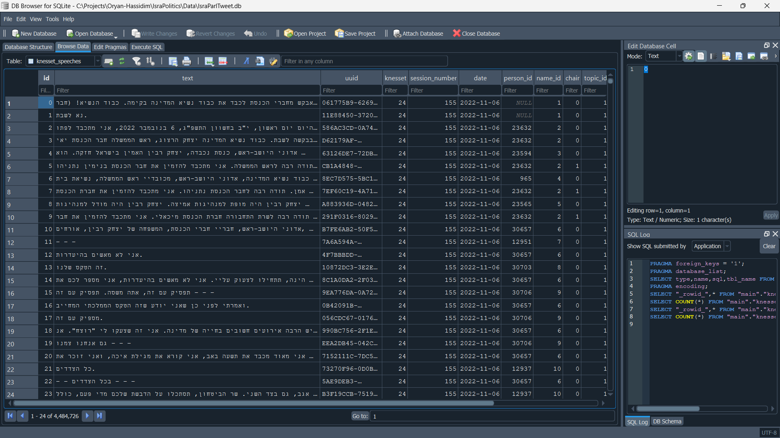
Our work so far
Processing information into useful database
Quotes to topic filter model
Website for manual tagging
Started training of main sentiment model (on one topic so far)
Started designing the UI

Slide 6
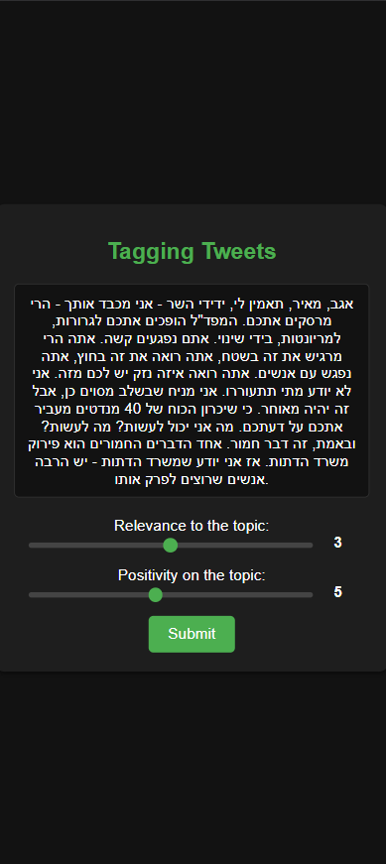
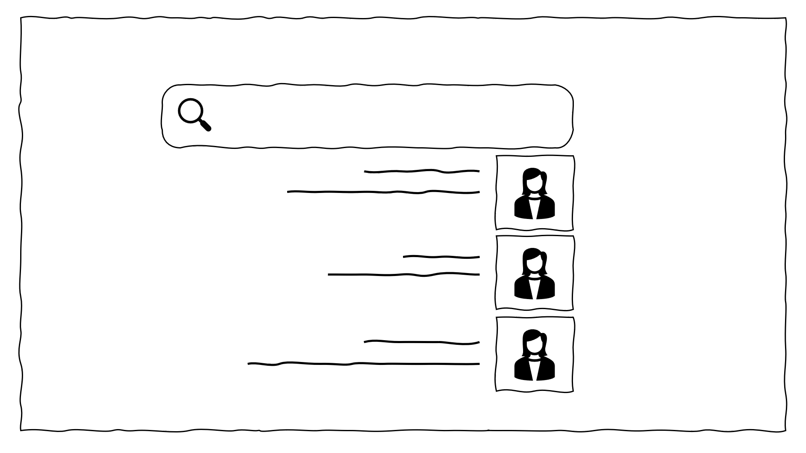
Our work so far
Processing information into useful database
Quotes to topic filter model
Website for manual tagging
Started training of main sentiment model (on one topic so far)
Started designing the UI

Slide 7
Our work so far
Processing information into useful database
Quotes to topic filter model
Website for manual tagging
Started training of main sentiment model (on one topic so far)
Started designing the UI

Slide 8
Our work so far
Processing information into useful database
Quotes to topic filter model
Website for manual tagging
Started training of main sentiment model (on one topic so far)
Started designing the UI

Slide 9
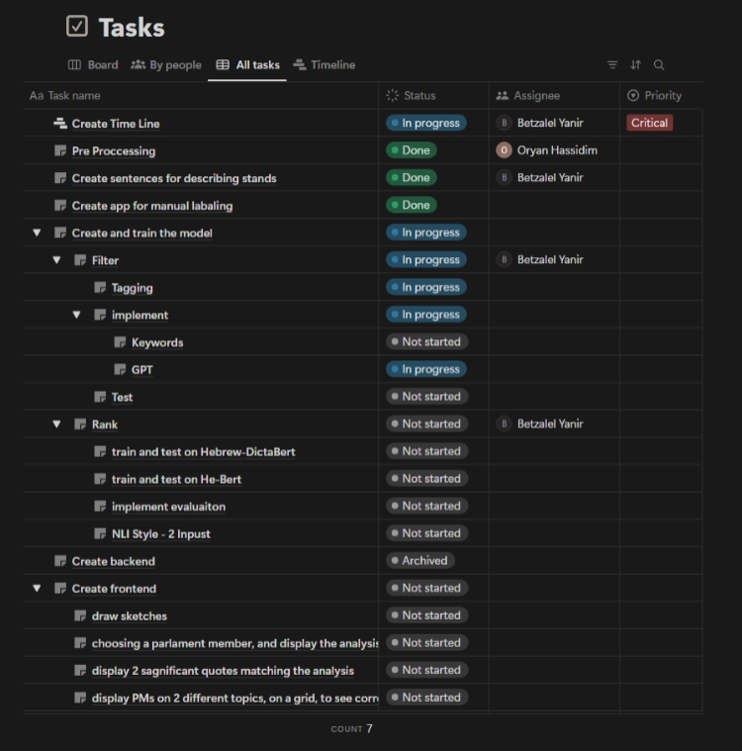
Notion

Slide 10
MVP
Full analysis of 2 main topics for 100~ MKs and parties
Interactive UI tool for exploring the data

Slide 11
Remaining tasks and challenges
Finishing the UI
Test the model using all our tools for the most successful one
Analyze quotes of the selected MKs
Adding more useful info, like consistency

